Slide 1
ECONOMIC THOUGHT

Slide 2
Production
production is a process of creating goods and services for satisfying peoples needs.

Slide 3
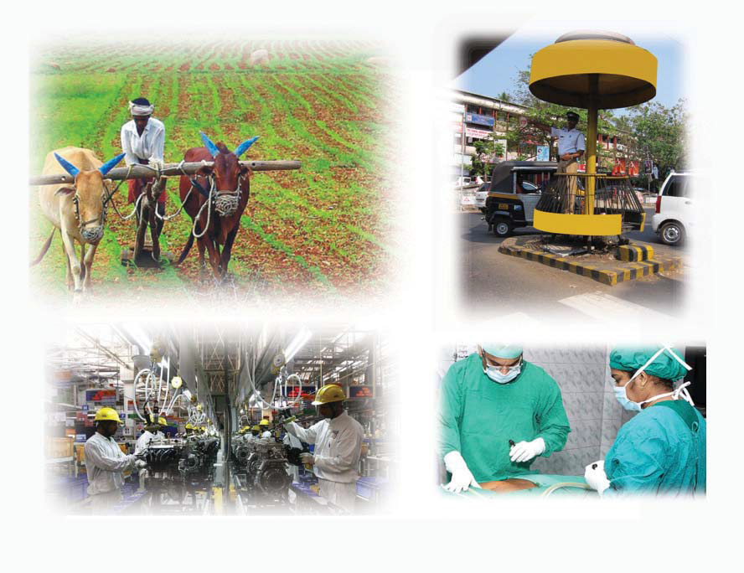

Slide 4
Agriculture and factory work come under production of goods,
whereas the traffic police and the doctor provide services.
distribution is significant in an economy. Fair distribution speeds up economic development.

Slide 5
Man satisfies his wants through the consumption of goods and services. The reward received by participating in the production process is spent on consumption. Therefore, there is a correlation between production, distribution and consumption of goods and services.

Slide 6
Economics is the branch of science that studies economic activities relating to production, distribution, and consumption.

Slide 7
The fundamental problems faced by an economy
There are three essential questions associated with every economic activity.
What to produce and how much to produce?
How to produce?
For whom to produce?

Slide 8
What to produce and how much to produce?
Since resources are limited, it is very important to use the available ones and to decide what to produce for the welfare of the society.
Food, shelter, clothing, hospitals, schools etc. should be made available according to the wants of the society. There should exist of balance between the wants of the society and the quantity of a product.

Slide 9
How to produce?
This denotes the method of production.
How to produce is decided on the basis of the availability of resources and technology.

Slide 10
For example, the services of labourers or machines can be utilized for agricultural activities like preparing land for cultivation, sowing, weeding, manuering, harvesting, and threshing.
The selection of a particular method is decided on the basis of available resources in an area.

Slide 11
For whom to produce?
Production is undertaken to satisfy the wants of the society.
Human wants are unlimited. As soon as one gets satisfied, another crops up.
However, we may not have the necessary resource to satisfy all our wants. Therefore, it is important to prioritize our wants.
We must plan production activities in such a way that it benefits the maximum number of individuals in the society.

Slide 12
how the income generated is distributed
The total income generated is distributed as interest on capital, profit of the entrepreneur, wages of the labour, and rent of the land.

Slide 13
Economics is not merely a study of wealth, it is also a study of man and society.

Slide 14
The contributions of economic thinkers

Slide 15
Adam Smith (1723-1790)
The father of Economics,
"An Enquiry into the Nature and Causes of the Wealth of Nations“
He described Economics as the study of wealth.
He wanted limited government intervention in the economic activities and argued for more freedom to individuals. This is known as the theory of 'Laissez Faire'.

Slide 16
Karl Marx (1818-1883)
He maintained that the basis of production is the manpower of labourers and that the price of a product is the reward for it. However, the laboures get only a portion while the lion's share goes to the capitalist as profit. Marx calls this surplus value.
He dreamed about a society where there is no difference between the ''haves'' and the ''have-nots''. The ideas of Marx are contained in his famous book 'Das Capital'.

Slide 17
Alfred Marshall (1842-1924)
He believed that wealth should ultimately result in the welfare of the society. Economic activities must be welfare oriented.
These principles are contained in his work 'Principles of Economics'.

Slide 18
Lionel Robbins (1898-1984)
British economist.
He suggested that we should prioritize our wants for the judicious utilization of limited resources.

Slide 19
Paul A Samuelson (1915-2009)
The American economist,
He maintained that a nation's financial stability depends on efficient economic planning and proper utilization of resources.

Slide 20
Indian economic thinkers

Slide 21
Chanakya (BCE 370 - 283)
The chief advisor of Chandragupta Maurya,
wrote the famous 'Arthasasthra'.
It is a major work of the Indian economic thoughts. Lack of effective economic activities can bring a nation to ruin.
Chanakya played a key role in making Magadha a powerful nation.

Slide 22
Dadabhai Naoroji (1825-1917)
He pointed out that the Britishers were draining our resources and that this led to economic crisis and poverty. This is known as the Drain Theory.

Slide 23
The main reasons for the drain of resources were the following.
The British officers in India were paid high salaries.
Goods made from Indian raw materials and resources bought at extremely low price were sold at a high price in the Indian market.
Indian wealth was robbed for expanding the British Empire.
Indian labourers were treated as slaves and farm and industrial products were exported to England.

Slide 24
Ramesh Chandra Dutt
His studies revealed how the western civilization and British exploitation ruined India.

Slide 25
Gandhian Economics
His ideas can be found in his first book 'Hind Swaraj', published in 1909.
Gandhiji's ideas gave importance to moral values and rural economy.
His idea of 'trusteeship' led to fresh thoughts in the area. Through trusteeship, Gandhiji aimed at an economy which is founded on truth and non-violence.

Slide 26
his main ideas as follows:
• Priority to rural-agricultural system.
• Emphasis on small and cottage industries.
• Formation of an economy built on equality.
• A self sufficient and self-reliant local economy.

Slide 27
Many Indian economists were impressed by the economic ideas of Gandhiji.
Economists like
J C Kumarappa,
Sriman Narayan, and
Dharampal
wanted independent India's development to give priority to agriculture and small scale industry.

Slide 28
Amartys Sen (1933-)
Amartya Sen is an Indian economist, who received the Nobel Prize for Economics in 1998.
His major works covered vast areas like welfare economics, economic inequality, and development.
He pointed out the flaws in determining the poverty line and concentrated his studies on povery, inequality, and famine.

